Slide 1

FPGA Design for Embedded Systems
[Video Title]
[Instructor Name(s)]
[Department Name]
Hardware Description Languages for Logic Design
Copyright © 2019 University of Colorado

Slide 2
An Introduction to VHDL
VHDL is a powerful and efficient language for logic design.
Now that the basics have been introduced, in this Module we will further explore how to use VHDL to design circuits through many examples and techniques.
Copyright © 2019 University of Colorado

Slide 3
Learning to Speak VHDL
Like learning any other language...
Learn key phrases, practice them
begun
Learn Grammar and Syntax
done
Make compound sentences
Practice, Practice, Practice
Copyright © 2019 University of Colorado

Slide 4
Writing VHDL : A 4-bit Register
D3
D2
D1
D0
D
Q
D
Q
D
Q
D
Q
En
En
En
En
R
R
R
R
Clk
Load
Reset
Copyright © 2019 University of Colorado

Slide 5
Writing VHDL : A 4-bit Register
-- Architecture
architecture Reg_Arch of Data_Reg is
begin dreg_proc : process (clk, reset, load)
begin
if (reset='0') then q <= "0000";
elsif (rising_edge(clk)) then
if (load='1') then q <= d;
end if;
end if;
end process dreg_proc;
end architecture Reg_Arch;a
Copyright © 2019 University of Colorado

Slide 6
Videos in this VHDL Module
Learning to Speak VHDL (this video)
Combinatorial Circuits
Synchronous Logic: Latches and Flip Flops
Synchronous Logic: Counters and Registers
Interface: Buses and Tri-state Buffers
Modular Design in VHDL
Test Benches in VHDL - Combinatorial
Test Benches in VHDL – Synchronous
Memories in VHDL
Finite State Machines in VHDL
Copyright © 2019 University of Colorado

Slide 7
Combinatorial Circuits in VHDL
In this video you will learn :
How to describe combinatorial circuits in VHDL
How to reduce vector sizes using reduction operators
Copyright © 2019 University of Colorado

Slide 8
Basic Gate Assignments in VHDL
A
W
A
B
B
A
Z
U
C
B
D
C
X
D
C
Y
D
vA[0]
vA[0]
vY[0]
vX[0]
vB[0]
vB[0]
vA[1]
vA[1]
vX[1]
vB[1]
vY[1]
vB[1]
vA[2]
vA[2]
vX[2]
vB[2]
vY[2]
vB[2]
vA[3]
vA[3]
vY[3]
vB[3]
vX[3]
vB[3]
Copyright © 2019 University of Colorado

Slide 9
Basic Gate Assignments in VHDL
-- Entity
entity gates is port (
vA, vB : in std_logic_vector(3 downto 0);
A,B,C,D : in std_logic;
W,U,X,Y,Z : out std_logic;
vX, vY : out std_logic_vector(3 downto 0) );
end entity gates;
-- Architecture
architecture RTL of gates is
begin
W <= A and B; U <= A nor B; --AND, NOR
X <= C xor D; Y <= C xnor D; --XOR, XNOR
Z <= (A and B) or (C and D); --AND-OR
vX <= vA and vB; -- Vector bitwise AND
vY <= vA or vB; -- Vector bitwise OR
end architecture RTL;
Copyright © 2019 University of Colorado

Slide 10
Vector Reduction
in VHDL
-- Entity : Note: use IEEE.std_logic_misc.all;
entity gates is port (
vA, vB, vC, vD : in std_logic_vector(3 downto 0);
W,U,X,Y,Z : out std_logic );
end entity gates;
-- Architecture : reduction after VHDL-2008 tools
architecture RTL of gates is
begin
W <= AND_REDUCE(vA); -- Vector Reduction AND
U <= NOR_REDUCE(vB); -- Vector Reduction NOR
X <= XOR_REDUCE(vD); -- Vector Reduction XOR
Y <= OR_REDUCE(vA) and vB(0); -- OR Red, bit AND
Z <= OR_REDUCE(vA and vB); -- Bit AND, OR Red
end architecture RTL;
Copyright © 2019 University of Colorado

Slide 11
Vector Reduction in VHDL
vA[0]
vA[0]
vA[1]
W
vA[1]
vA[2]
vA[2]
Y
vA[3]
vA[3]
vB[0]
vB[0]
vB[1]
vD[0]
U
vD[1]
vB[2]
X
vB[3]
vD[2]
vD[3]
vA[0]
vB[0]
vA[1]
Z
vB[1]
vA[2]
vB[2]
vA[3]
vB[3]
Copyright © 2019 University of Colorado

Slide 12
Procedural Logic in VHDL
-- Entity
entity gates is port (
A,B,C,D : in std_logic;
Y : out std_logic );
end entity gates;
-- Architecture
architecture combo of gates is
begin combo_process : process (A,B,C,D)
begin
if ((C='1') and (D='1')) then Y <= '0';
elsif ((A='1') or (B='1')) then Y <= '1’;
else Y <= '0';
end if;
end process combo_process;
end architecture combo;
Copyright © 2019 University of Colorado

Slide 13
Procedural Logic in VHDL - Circuit
A
B
Y
C
D
Copyright © 2019 University of Colorado

Slide 14
Procedural Logic – Gotcha, Latch Generate
-- Entity
entity gates is port (
A,B,C,D : in std_logic;
Y : out std_logic );
end entity gates;
-- Architecture
architecture combo of gates is
begin combo_process : process (A,B,C,D)
begin
if ((C=‘1’) and (D=‘1’)) then Y <= ‘0’;
elsif ((A=‘1’) or (B=‘1’)) then Y <= ‘1’;
end if; -- Missing Else condition for Y
end process combo_process;
end architecture combo;
Copyright © 2019 University of Colorado

Slide 15
Procedural Logic – Gotcha, Latch Generate
Incomplete Assignment
‘1’
A
B
Latch
D
C Q
R
Y
C
D
Copyright © 2019 University of Colorado

Slide 16
Summary – VHDL for Combinatorial Circuits
In this video, you have learned:
How to describe combinatorial circuits in VHDL using either assignment statements
How to reduce vector sizes using operators as bus to bit reduction operators
How to prevent unintentional latches in logic circuits
Copyright © 2019 University of Colorado

Slide 17
Synchronous Logic : D Latch
How can we make a D Latch in VHDL?
D
Q
GATE
CLR
Copyright © 2019 University of Colorado

Slide 18
Synchronous Logic : D Latch
-- Entity
entity DLatches is port (
d, gate, clr : in std_logic;
q : out std_logic );
end entity DLatches;
-- Architecture
architecture LArch of DLatches is begin
latch_proc_1 : process (gate, d)
begin
if (gate='1') then q <= d;
-- No rising_edge()
end if;
-- No gate=0 value, so latch inferred
end process latch_proc_1;
Copyright © 2019 University of Colorado

Slide 19
Synchronous Logic : D Latch
-- another Latch example
latch_proc_2 : process (gate, d, clr)
begin
if (clr ='1') then q <= '0';
elsif (gate='1') then q <= d;
end if;
end process latch_proc_2;
end architecture LArch;
Copyright © 2019 University of Colorado

Slide 20
Combinatorial Logic
Finite time for best case or worst case logic value to propagate a result through wires and logic cells across the chip
0 -> 1 transition for path C to Y
0.2 + 0.9 + 0.3 + 1.1 + 0.2 = 2.7nano seconds
[Video Title]
D
C
0.2ns
0.3ns
Y
0.9ns
0.2ns
A
E
1.1ns
B
Copyright © 2019 University of Colorado

Slide 21
Synchronous Logic
Logic path synchronized to CLK
D
Y
D Q
C
A
E
B
CLK
Reset
Copyright © 2019 University of Colorado

Slide 22
Synchronous Logic : D Flip Flop
How can we make a D Flip Flop in VHDL?
D
Q
R
Copyright © 2019 University of Colorado

Slide 23
Synchronous Logic : D Flip Flop – Sync Reset
-- Entity
entity DFF is port (
d, clk, reset : in std_logic;
q : out std_logic );
end entity DFF;
Copyright © 2019 University of Colorado

Slide 24
Synchronous Logic : D Flip Flop – Sync Reset
-- Architecture,
-- could use (clk'event and clk='1')
architecture DFF_Arch of DFF is
begin dff_proc_1 : process (clk)
begin
if (rising_edge(clk)) then
if (reset='1') then q <= '0';
-- Sync Reset
else q <= d;
end if;
end if;
end process dff_proc_1;
end architecture DFF_Arch;
Copyright © 2019 University of Colorado

Slide 25
Synchronous Logic : D Flip Flop – Async Reset
How can we make a D Flip Flop in VHDL?
S
D
Q
R
Copyright © 2019 University of Colorado

Slide 26
Synchronous Logic : D Flip Flop – Async Reset
-- Entity
entity DFF is port (
d, clk, set, reset : in std_logic;
q : out std_logic );
end entity DFF;
-- Architecture, Next Slide
Copyright © 2019 University of Colorado

Slide 27
Synchronous Logic : D Flip Flop – Async Reset
-- Architecture
architecture DFF_Arch of DFF is
begin dff_proc_2 : process (clk, set, reset)
begin
if (reset='1') then q <= '0';
-- Async
elsif (rising_edge(clk)) then
if (set='0') then q <= '1';
-- Sync
else q <= d;
-- Sync
end if;
end if;
end process dff_proc_2;
end architecture DFF_Arch;
Copyright © 2019 University of Colorado

Slide 28
Synchronous Logic : D Flip Flop
How can we make a Clock Enable in VHDL?
D
Q
En
R
Copyright © 2019 University of Colorado

Slide 29
Synchronous Logic : D Flip Flop – Clock Enable
-- Entity
entity DFF is port (
d, clk, ce, reset : in std_logic;
q : out std_logic );
end entity DFF;
-- Architecture, Next Slide
Copyright © 2019 University of Colorado

Slide 30
Synchronous Logic : D Flip Flop – Clock Enable
-- Architecture
architecture DFF_Arch of DFF is
begin dff_proc_3 : process (clk, ce, reset)
begin
if (reset='1') then q <= '0';
-- Async
elsif (rising_edge(clk)) then
if (ce='1') then q <= d;
-- Sync
end if;
end if;
end process dff_proc_3;
end architecture DFF_Arch;
Copyright © 2019 University of Colorado

Slide 31
Summary – VHDL for Synchronous Circuits
In this video, you have learned:
How to describe synchronous circuits in VHDL
How to design flip flops with synchronous and asynchronous set and reset
Copyright © 2019 University of Colorado

Slide 32
Synchronous Circuits in VHDL
In this video you will learn :
How to describe synchronous circuits in VHDL
How to design registers and counters in VHDL
Copyright © 2019 University of Colorado

Slide 33
Synchronous Logic : Data Register
Data is stored in a register for later use. How can we make a data register in VHDL?
D3
D2
D1
D0
D
Q
D
Q
D
Q
D
Q
En
En
En
En
R
R
R
R
Clk
Load
Reset
Q3
Q2
Q1
Q0
Copyright © 2019 University of Colorado

Slide 34
Synchronous Logic : Data Register
-- Entity
entity Data_Reg is port (
clk, reset, load : in std_logic;
d : in std_logic_vector(3 downto 0);
q : out std_logic_vector(3 downto 0));
end entity Data_Reg;
-- Architecture Next Slide
Copyright © 2019 University of Colorado

Slide 35
Synchronous Logic : Data Register
-- Architecture
architecture Reg_Arch of Data_Reg is
begin dreg_proc : process (clk, reset, load)
begin
if (reset='0') then q <= "0000";
elsif (rising_edge(clk)) then
if (load='1') then q <= d;
end if;
end if;
end process dreg_proc;
end architecture Reg_Arch;a
Copyright © 2019 University of Colorado

Slide 36
Synchronous Logic : Shift Register
How can we make a shift register in VHDL?
D0 -> D1 -> D2 -> D3
D0
D
Q
D
Q
D
Q
D
Q
En
En
En
En
R
R
R
R
Clk
Shift
Reset
Q0
Q1
Q2
Q3
Copyright © 2019 University of Colorado

Slide 37
Synchronous Logic : Shift Register
-- Entity
entity Shift_Reg is port (
clk, reset, shift, d0 : in std_logic;
q : out std_logic_vector(3 downto 0));
end entity Shift_Reg;
-- Architecture Next Slide
Copyright © 2019 University of Colorado

Slide 38
Synchronous Logic : Shift Register
-- Architecture, could SLL or shift_left(q,1)
architecture SREG_Arch of Data_Reg is begin
sreg_proc : process (clk, reset)
begin
if (reset='0') then q <= "0000";
elsif (rising_edge(clk)) then
if (shift='1') then
q(0) <= d0;
q(1) <= q(0);
q(2) <= q(1);
q(3) <= q(2);
end if;
end if;
end process sreg_proc;
end architecture SREG_Arch;
Copyright © 2019 University of Colorado

Slide 39
Synchronous Logic : Binary Counter
How can we make a binary counter in VHDL?
Data (D3..D0)
Reset
Load
En
Counter
Clock
Q (D3..D0)
Copyright © 2019 University of Colorado

Slide 40
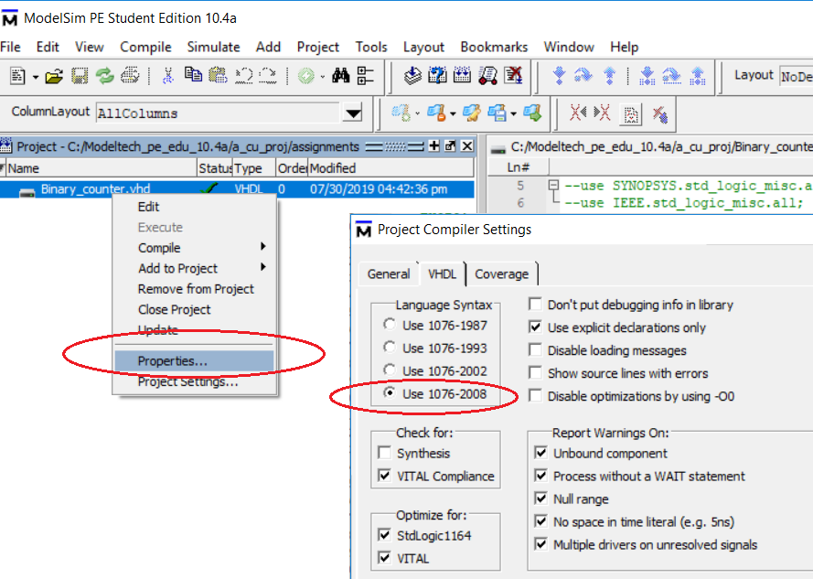
Synchronous Logic : Binary Counter
Compile : Use ModelSim Library - 2008
Copyright © 2019 University of Colorado

Slide 41
Synchronous Logic : Binary Counter
-- Entity
entity Counter is port (
clk, reset, load, en : in std_logic;
d : in std_logic_vector(3 downto 0);
q : out std_logic_vector(3 downto 0));
end entity Counter;
-- Architecture Next Slide
Copyright © 2019 University of Colorado

Slide 42
Synchronous Logic : Binary Counter
-- Architecture
architecture Counter_Arch of Counter is begin
count_proc : process (clk, reset, load, en)
begin
if (reset='1') then q <= "0000";
elsif (rising_edge(clk)) then
if (load='1') then q <= d;
elsif (en='1') then q <= q + 1;
--2008
end if;
end if;
end process count_proc;
end architecture Counter_Arch;
Copyright © 2019 University of Colorado

Slide 43
Synchronous Logic : Register File
Register Files are useful constructs that allow addressing of registers. Each flop is assumed as an n-bit register.
wdata
D
Q
En
D
Q
rdata
wAddress
En
Decoder
D
Q
wren
En
Clk
D
Q
En
rAddress
Copyright © 2019 University of Colorado

Slide 44
Synchronous Logic : Register File
-- Entity -- use IEEE.numeric_std.all; integer conversion
entity regFile is
generic (Dwidth : integer := 8;
Awidth : integer := 2 );
port (
clk, wren : in std_logic;
wdata : in std_logic_vector(Dwidth-1 downto 0);
waddr, raddr : in std_logic_vector(Awidth-1 downto 0);
rdata : out std_logic_vector(Dwidth-1 downto 0) );
end entity regFile;
-- Architecture, Next Slide
Copyright © 2019 University of Colorado

Slide 45
Synchronous Logic : Register File
-- Architecture
architecture RFile_Arch of regFile is
type array_type (0 to 2**Awidth-1) of std_logic_vector (Dwidth-1 downto 0);
signal array_reg : array_type;
begin rf_proc : process (clk, wren, wdata, waddr, raddr)
begin
if (rising_edge(clk)) then
if (wren='1') then
array_reg(to_integer(unsigned(waddr))) <= wdata;
end if;
rdata <= array_reg(to_integer(unsigned(raddr)));
end if;
end process rf_proc;
end architecture RFile_Arch;
Copyright © 2019 University of Colorado

Slide 46
Summary – VHDL for Synchronous Circuits
In this video, you have learned:
How to describe synchronous circuits :
Data Register
Shift Register
Counter
Register File
Copyright © 2019 University of Colorado

Slide 47
Bus Systems in VHDL
In this video you will learn :
How to make tri-state and bi-directional bus systems
How to join and separate buses
Copyright © 2019 University of Colorado

Slide 48
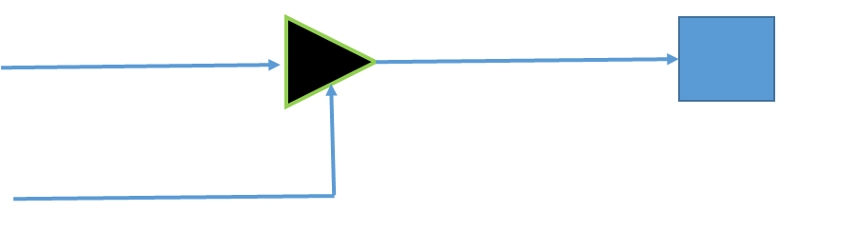
Tri-state Buses
External connections on FPGA pins are often in a group of related signals known as a bus.
The I/O structure of FPGAs often allow the bus to be tri-stated, so that multiple drivers can be attached to the IO at the same time, with only one driver active.
Copyright © 2019 University of Colorado

Slide 49
Tri-state in VHDL
-- Entity
entity y_tri is port (
OE : in std_logic;
Dout : in std_logic_vector(3 downto 0);
Pinout : out std_logic_vector(3 downto 0) );
end entity y_tri;
-- Architecture
architecture tri_arch of y_tri is
begin
Pinout <= Dout when (OE='1'),
(others => "ZZZZ") when others ;
end architecture tri_arch;
Copyright © 2019 University of Colorado

Slide 50
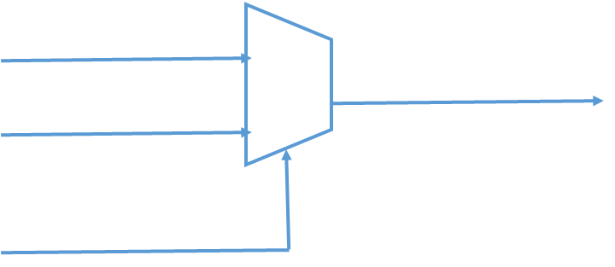
Tri-state Buses
When driving external tri-stated buses, som protocol should be used to assure that only one drive is active on the bus at a time.
VHDL code can define tri-state buses, but tri-state buses are typically not implemented inside of an FPGA but rather as a mux/multiplexer.
Copyright © 2019 University of Colorado

Slide 51
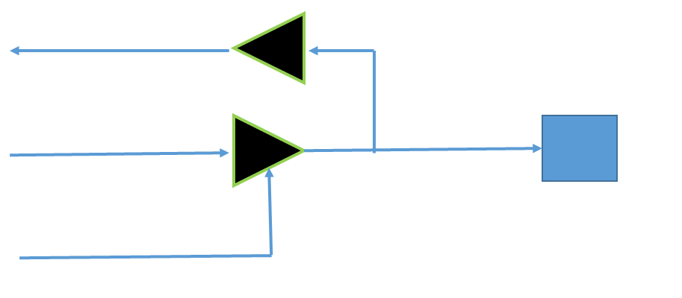
Bi-directional Buses
The I/O structure of the FPGA will also allow us to create Bi-directional buses, in which the external pin can be treated as either an input or an output, depending on the state of the enable signal.
Copyright © 2019 University of Colorado

Slide 52
Bi-directional Buses in VHDL
-- Entity
entity bidir is port (
OE : in std_logic;
Dout : in std_logic_vector(3 downto 0);
Din : out std_logic_vector(3 downto 0);
IOpin : inout std_logic_vector(3 downto 0) );
end entity bidir;
-- Architecture, Next Slide
Copyright © 2019 University of Colorado

Slide 53
Bi-directional Buses in VHDL
-- Architecture
architecture bidir_arch of bidir is
begin bi_proc : process (OE, Dout)
begin
Din <= IOpin;
if (OE='1') then IOpin <= Dout;
elsif (OE='0') then IOpin <= "ZZZZ";
else IOpin <= "XXXX";
end if;
end process bi_proc;
end architecture bidir_arch;
Copyright © 2019 University of Colorado

Slide 54
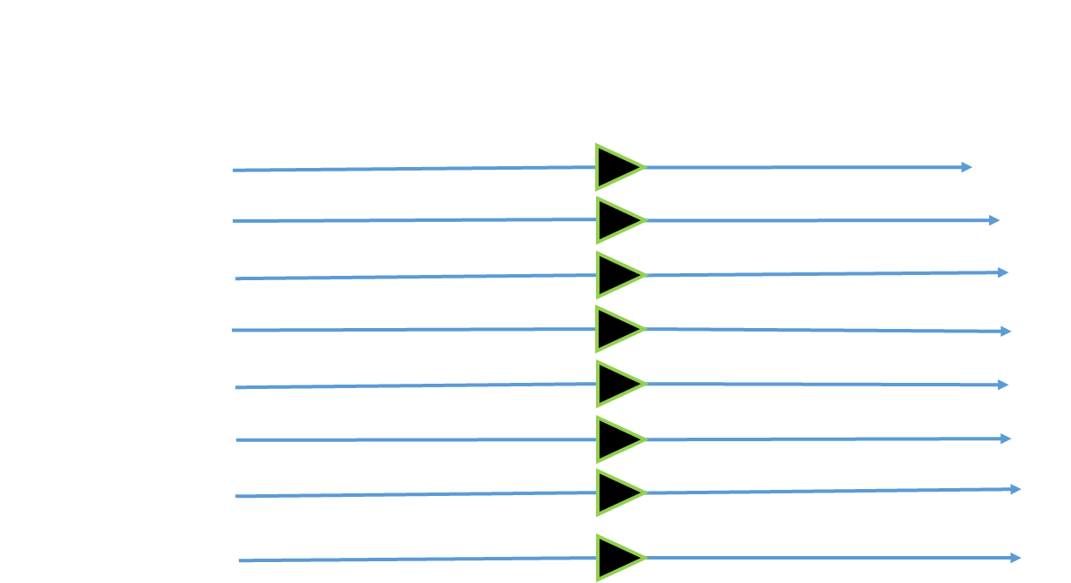
Joining and Splitting Buses
VHDL includes the concatenation operator which allows buses to be combined. Splitting buses can be done using indexing.
Copyright © 2019 University of Colorado

Slide 55
Joining Buses in VHDL
-- Entity
entity bus_js is port (
A : in std_logic_vector(4 downto 0);
B : in std_logic_vector(2 downto 0);
X, Y : out std_logic;
Dout : out std_logic_vector(5 downto 0) );
end entity bus_js;
-- Architecture
architecture js_arch of bus_js is
begin js_proc : process (A,B) begin
Dout <= (B(2) & B(1) & B(0) &
A(2) & A(1) & A(0));
X <= A(3);
Y <= A(4);
end process js_proc;
end architecture js_arch;
Copyright © 2019 University of Colorado

Slide 56
Summary – VHDL for Bus Systems
In this video, you have learned:
How to make tri-state and bi-directional bus systems
How to join and separate buses
Copyright © 2019 University of Colorado

Slide 57
Modular Design in VHDL
In this video, you will learn:
How to build bigger designs using modular design techniques
Use of loops in VHDL
How to use Generate to make copies of circuits
Copyright © 2019 University of Colorado

Slide 58
Modular Design in VHDL
Many tools are provided in VHDL to make modular designs, including :
Component Instantiation
Looping
Generate Blocks
Tasks and Functions
Copyright © 2019 University of Colorado

Slide 59
Component Instantiation in VHDL
A modular design in VHDL at the architecture level oftentimes consists only of component instantiations, which is the fundamental way to build hierarchy in a design.
architecture MY_HIER of MY_UPPER is
component MY_LOWER_OR port (
A,B : in std_logic;
Z : out std_logic);
end component;
begin
MY_INST_1 : MY_LOWER_OR port_map (
A=>A_UP, B=>B_UP, Z=>Z_UP);
MY_INST_N : ...
end architecture MY_HIER;
Copyright © 2019 University of Colorado

Slide 60
Component Instantiation in VHDL
architecture Add16_Arch of Add16 is
component Add4 port (
A,B : in std_logic_vector(3 downto 0);
Cin : in std_logic; Cout : out std_logic);
Sum : in std_logic_vector(3 downto 0) );
end component;
Begin
Add4_u1 : Add4 port_map (
A=> A(3 downto 0), B=>(3 downto 0), Z=> Cin(0), Sum(3 downto 0) );
...
Add4_u4 : Add4 port_map (
A=> A(15 downto 12), B=>(15 downto 12), Z=> Cin(3), Sum(15 downto 12) );
end architecture Add16_Arch;
Copyright © 2019 University of Colorado

Slide 61
Looping in VHDL
There are several looping constructs in VHDL, including :
while, for
The for loop statement is written and behaves just like it does in C, as is the while loop.
The while loop executes a statement or block of statements until a condition like less than or a when compare is equal to exit or wait.
Copyright © 2019 University of Colorado

Slide 62
Looping in VHDL
-- Architecture
architecture Loop_Arch of my_loop is begin
while (I <= 8) loop
if (B = '1') then
Z(I) <= A(I);
end if;
I := I + 1;
end loop;
end architecture Loop_Arch;a
Copyright © 2019 University of Colorado

Slide 63
Generate in VHDL
Although loops can be used to generate data or test patterns, a common use of loops for synthesis is replication of many identical circuits within generate blocks.
The generate … end generate block specifies now an object is to be repeated.
The index variable of a for loop sets the number of elements to generate.
Copyright © 2019 University of Colorado

Slide 64
Generate in VHDL
-- Architecture
architecture XorGen_Arch of XorGen is begin
Gen_proc : for i in 0 to 7 generate
xout(i) <= xin1(i) xor xin(2);
end generate Gen_proc;
end architecture XorGen_Arch;a
Copyright © 2019 University of Colorado

Slide 65
Summary - Modular Design in VHDL
In this video, you have learned:
How to build bigger designs using modular design techniques
Use of loops in VHDL
How to use for ... Generate to make copies of circuits
Copyright © 2019 University of Colorado

Slide 66
Testbenches in VHDL
In this video you will learn :
The concept of using a VHDL program, called a testbench, to test another VHDL program (your code)
How to write simple testbenches
How to use loops to generate stimulus
How to use assertions to determine and report test results
Copyright © 2019 University of Colorado

Slide 67
What is a Testbench?
A testbench is a program written in any language for the purposes of exercising and verifying the functional correctness of the hardware model as coded.
Also known as a test fixture or test harness.
A testbench is a powerful tool for generating test stimulus and test results
Copyright © 2019 University of Colorado

Slide 68
Testbench Functional Sections
A testbench can have several functional sections, including:
Top-level testbench declaration
Stimulus, Response, and Component Signal declarations
Component (Device Under Test) instantiations
Test Monitor which logs results and reports mis-compares
Copyright © 2019 University of Colorado

Slide 69
Testbench Structure : Exercise the Core
INPUT :
Clock_IN
Reset_IN
Data_A_IN[31:0]
OUTPUT :
Div_CLK_OUT
Done_OUT
Data_B_OUT[31:0]
Testbench.VHD
Test Stimulus
Compare Results
Core.VHD
Device Under Test
Any Hierarchy
LOG FILE :
Compare Expected
Count Mis-Compares
Pass/Fail
Copyright © 2019 University of Colorado

Slide 70
Adder Test Bench
-- Entity : no port list !
entity tb_adder is end entity tb_adder;
-- Architecture
architecture test_arch of tb_adder is
component Add4 port (
Data1,Data2 : in std_logic_vector(3 downto 0);
Cin : in std_logic;
Cout : out std_logic;
Sum : out std_logic_vector(3 downto 0) );
end component Add4;
signal a_tb, b_tb : std_logic_vector(3 downto 0); -- INPUT
signal Cin : std_logic; -- INPUT
signal Sum_tb : std_logic_vector(3 downto 0); -- OUTPUT
signal Cout_tb : std_logic; -- OUTPUT
signal expect : std_logic_vector(3 downto 0); --expected
Copyright © 2019 University of Colorado

Slide 71
Adder Test Bench
begin
-- DUT Instantiation
DUT : Add4 port map (
Data1 => a_tb, Data2 => b_tb,
Cin => Cin, Cout => Cout_tb, Sum => Sum_tb);
-- Stimulus by hand drawn waves, poor coverage
stim_proc : process begin
wait for 0ns;
a_tb <= "0010"; b_tb <= "0010"; Cin <= '0'; expect <= "0100";
wait for 10ns;
a_tb <= "1111"; b_tb <= "0000"; Cin <= '1'; expect <= "0000";
wait for 10ns;
a_tb <= "0010"; b_tb <= "0100"; Cin <= '1'; expect <= "0111";
wait;
end process stim_proc;
Copyright © 2019 University of Colorado

Slide 72
Adder Test Bench
-- Monitor, use ieee.std_logic_textio.all;
-- use std.textio.all;
txt_out : process (Sum_tb, Cout_tb)
variable str_o : line;
begin
write(str_o, string'(" a=")); write(str_o, a_tb);
write(str_o, string'(" b=")); write(str_o, b_tb);
write(str_o, string'(" cin=")); write(str_o, Cin);
write(str_o, string'(" sum=")); write(str_o, Sum_tb);
write(str_o, string'(" cout=")); write(str_o, Cout_tb);
write(str_o, string'(" expect=")); write(str_o, expect);
assert false report time'image(now) & str_o.all
severity note;
end process txt_out;
end architecture test_arch;
Copyright © 2019 University of Colorado

Slide 73
Adder Test Bench => Text Output ModelSim
VSIM 10 > run
# ** Note: 0 ns a=UUUU b=UUUU cin=U sum=UUUU cout=U expect=UUUU
# Time: 0 ns Iteration: 0 Instance: /tb_adder
# ** Warning: There is an 'U'|'X'|'W'|'Z'|'-' in an arithmetic operand, the result will be 'X'(es).
# Time: 0 ns Iteration: 0 Instance: /tb_adder/DUT
# ** Warning: There is an 'U'|'X'|'W'|'Z'|'-' in an arithmetic operand, the result will be 'X'(es).
# Time: 0 ns Iteration: 0 Instance: /tb_adder/DUT
# ** Note: 0 ns a=0010 b=0010 cin=0 sum=XXXX cout=X expect=0100
# Time: 0 ns Iteration: 2 Instance: /tb_adder
# ** Note: 0 ns a=0010 b=0010 cin=0 sum=0100 cout=0 expect=0100
# Time: 0 ns Iteration: 4 Instance: /tb_adder
# ** Note: 10 ns a=1111 b=0000 cin=1 sum=0000 cout=1 expect=0000
# Time: 10 ns Iteration: 3 Instance: /tb_adder
# ** Note: 20 ns a=0010 b=0100 cin=1 sum=0111 cout=0 expect=0111
# Time: 20 ns Iteration: 3 Instance: /tb_adder
write(str_o, string'(" cout=")); write(str_o, Cout_tb);
Copyright © 2019 University of Colorado

Slide 74
Adder Test Bench => Text Output ModelSim
(ModelSim : Time messages removed)
# ** Note: 0 ns a=0010 b=0010 cin=0 sum=XXXX cout=X expect=0100
# ** Note: 0 ns a=0010 b=0010 cin=0 sum=0100 cout=0 expect=0100
# ** Note: 10 ns a=1111 b=0000 cin=1 sum=0000 cout=1 expect=0000
# ** Note: 20 ns a=0010 b=0100 cin=1 sum=0111 cout=0 expect=0111
Copyright © 2019 University of Colorado

Slide 75
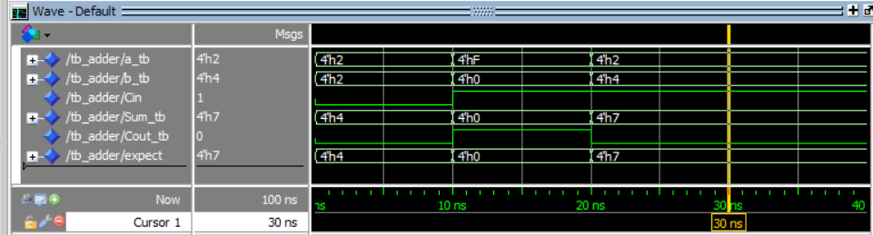
Adder Test Bench => Wave Output ModelSim
Copyright © 2019 University of Colorado

Slide 76
Adder Test Bench : Automation with Loops
-- Architecture : Generates coverage and expected stimulus
Loop_proc: process
variable i, j, k : integer;
begin
for i in 0 to 15 loop a_tb <= i;
for j in 0 to 15 loop b_tb <= j;
for k in 0 to 1 loop
Cin <= k;
wait for 10ns;
expect <= a_tb + b_tb + Cin;
end loop;
end loo;
end loop;
end process Loop_proc;
end architecture test_arch;
Copyright © 2019 University of Colorado

Slide 77
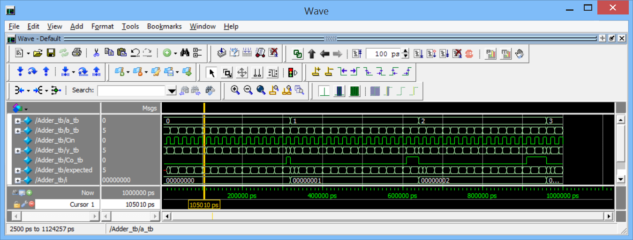
Adder Test Bench : Waves for Loops
Copyright © 2019 University of Colorado

Slide 78
Adder Test Bench : Self Checking
From the previous slide, Replace
expect <= a_tb + b_tb + Cin;
with
if (sum_tb /= a_tb + b_tb + Cin) then
write(str_o, string'(“Error - Sum”));
writeline(output, str_o);
wait;
end if;
Copyright © 2019 University of Colorado

Slide 79
Summary – VHDL for Combinatorial Circuits
In this video, you have learned:
How to use loops to generate stimulus
How to use assertions to report test results
Copyright © 2019 University of Colorado

Slide 80
Counter Test Bench
Counter Test Process
Data (D3..D0)
En
Load
Reset Generator
Reset
Counter DUT
Clock
Clock generator
Qexpected (D3..D0)
Q (D3..D0)
Compare
Copyright © 2019 University of Colorado

Slide 81
Counter Test Bench
-- Testbench Entity : No port list
entity Counter_tb is end entity Counter_tb;
-- Testbench Architecture
architecture Counter_arch of Counter_tb is
component Counter port (
d : in std_logic_vector(3 downto 0);
clk, reset, load, en : in std_logic;
q : out std_logic_vector(3 downto 0));
end component Counter;
constant delay : integer := 10; -- wait
constant n : integer := 4; -- width counter
constant T : time := 20 ns; -- clock period
signal clock : std_logic := '0'; -- clock generator
signal reset : std_logic := '0'; -- reset generator
Copyright © 2019 University of Colorado

Slide 82
Counter Test Bench
-- Architecture
signal data_tb : std_logic_vector(n-1 downto 0) :=
"0000";
signal load : std_logic := '0'; -- stimulus
signal en : std_logic := '0'; -- stimulus
signal q_tb : std_logic_vector(3 downto 0);
-- output
signal check : std_logic_vector(n-1 downto 0) :=
"0000"; -- compare to count
Copyright © 2019 University of Colorado

Slide 83
Counter Test Bench
begin
-- DUT Instantiation
DUT : Counter port map (
d => data_tb,
clk => clock, reset => reset,
load => load, en => en,
q => q_tb );
clk_gen : process begin
clock <= '0';
wait for T/2; -- 10 nsec of 0
clock <= '1';
wait for T/2; -- 10 nsec of 1, for 20 nsec period
end process;
reset <= '1', '0' after 10 ns; -- 10 nsec
Copyright © 2019 University of Colorado

Slide 84
Counter Test Bench
test_proc : process
variable line_o : line;
begin
wait until falling_edge(reset); -- wait for reset
wait until falling_edge(clock); -- wait for a clock
load <= '1'; en <= '0';
data_tb <= "1010";
wait until falling_edge(clock);
if (q_tb /= "1010") then
write(line_o, string'("Load fail "));
write(line_o, q_tb);
writeline(output, line_o);
end if;
Copyright © 2019 University of Colorado

Slide 85
Counter Test Bench
check <= "1010";
load <= '0';
en <= '1';
wait for 1 ns;
for i in 1 to 2**n loop
check <= check + 1;
wait until falling_edge(clock);
if (q_tb /= check ) then
report "count fail at time count" &
time'image(now) & integer'image(i);
end if;
end loop;
wait;
end process test_proc;
end architecture Counter_arch;
Copyright © 2019 University of Colorado

Slide 86
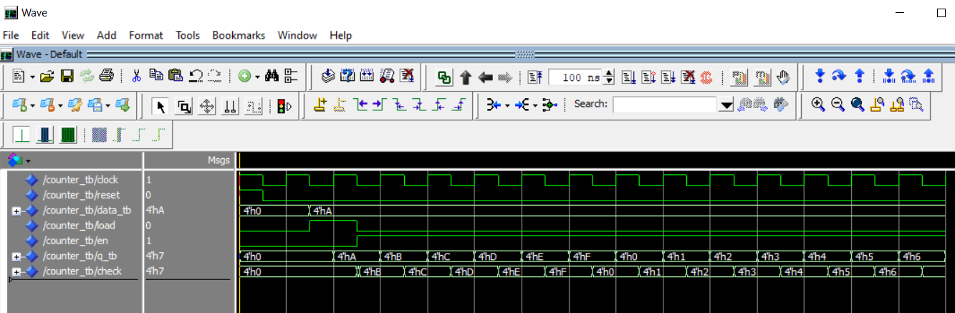
Counter Test Bench Waves
Copyright © 2019 University of Colorado

Slide 87
Memory in VHDL
Memories are a common element in most digital systems.
Earlier in this course we described a register file circuit, in which individual registers were enabled for access by decoding an address.
We will extend this to include RAM and ROM memories.
Copyright © 2019 University of Colorado

Slide 88
Synchronous Logic : Register File
Register Files are useful constructs that allow addressing of registers. Here we assume each flip flop represents an n-bit register.
wdata
D
Q
En
D
Q
rdata
wAddress
En
Decoder
D
Q
wren
En
Clk
D
Q
En
rAddress
Copyright © 2019 University of Colorado

Slide 89
Dual Port RAM
-- Entity
entity DPRAM is
generic (D_Width : integer := 8;
A_Width : integer := 10 ); -- 2**10 = 1024
port (
clk, we : in std_logic;
d : in std_logic_vector(D_Width-1 downto 0);
w_add, r_add : in std_logic_vector(A_Width-1 downto 0);
q : out std_logic_vector(D_Width-1 downto 0) );
end entity DPRAM;
-- Architecture, Next Slide
Copyright © 2019 University of Colorado

Slide 90
Dual Port RAM
architecture DPR_Arch of DPRAM is -- Architecture
type ram_type is array (0 to 2**A_Width-1) of
std_logic_vector (D_Width-1 downto 0);
impure function read_file(txt_file : in string) return ram_type is
file ram_file : text open read_mode is txt_file;
variable txt_line : line;
variable txt_bit : bit_vector(D_Width-1 downto 0);
variable txt_ram : ram_type;
begin for i in ram_type'range loop
readline(ram_file, txt_line);
read(txt_line, txt_bit);
txt_ram(i) := to_stdlogicvector(txt_bit);
end loop; return txt_ram;
end function;
https://www.fpga4student.com/2018/08/how-to-read-image-in-vhdl.html
Copyright © 2019 University of Colorado

Slide 91
Dual Port RAM
-- Architecture
signal ram : ram_type := read_file("initialRAM.txt");
-- Read the ram text file from the function
signal data_reg : std_logic_vector (D_Width-1 downto 0);
begin ram_proc : process (clk)
begin
if (rising_edge(clk)) then
if (we='1') then
ram(to_integer(unsigned(w_add))) <= d;
data_reg <= ram(to_integer(unsigned(r_add))) ;
end if;
end if;
q <= data_reg ;
end process ram_proc;
end architecture DPR_Arch;
https://www.fpga4student.com/2018/08/how-to-read-image-in-vhdl.html
Copyright © 2019 University of Colorado

Slide 92
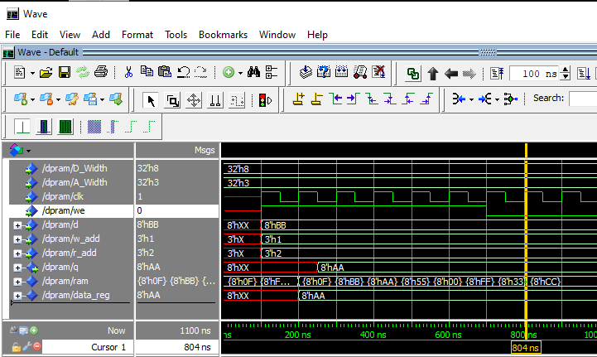
Dual Port RAM
-- Short RAM Text File : address 0 to 7, 8 bits
00001111
11110000
10101010
01010101
00000000
11111111
00110011
11001100
Copyright © 2019 University of Colorado

Slide 93
ROM Memory
entity ROM is -- Entity
generic (D_Width : integer := 8;
A_Width : integer := 3 ); -- 2**3 = 8 address
port (
clk : in std_logic;
addr : in std_logic_vector(A_Width-1 downto 0);
data : out std_logic_vector(D_Width-1 downto 0) );
end entity ROM;
architecture ROm_Arch of ROM is -- Architecture
signal rom_d, data_reg : std_logic_vector
(D_Width-1 downto 0);
signal addr_sel : std_logic_vector (2 downto 0);
Copyright © 2019 University of Colorado

Slide 94
ROM Memory
begin
addr_sel <= addr;
rom_proc : process (clk) begin
data_reg <= rom_d;
end process rom_proc;
https://www.fpga4student.com/2018/08/how-to-read-image-in-vhdl.html
Copyright © 2019 University of Colorado

Slide 95
ROM Memory
lookup_proc : process begin -- Lookup Table
case(addr_sel) is
when "000" => rom_d <= "10000000"; when "100" => rom_d <= "00000000";
when "001" => rom_d <= "10101010"; when "101" => rom_d <= "10011001";
when "010" => rom_d <= "01010101"; when "110" => rom_d <= "10000001";
when "011" => rom_d <= "10000011"; when "111" => rom_d <= "11110000";
when others => rom_d <= "00000000"; -- +700 cases possible, X, U
end case;
end process lookup_proc;
data <= data_reg;
end architecture ROM;
https://www.fpga4student.com/2018/08/how-to-read-image-in-vhdl.html
Copyright © 2019 University of Colorado

Slide 96
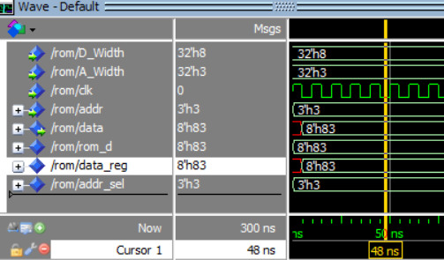
ROM Memory : Wave Addr=h3
Copyright © 2019 University of Colorado

Slide 97
Summary – RAM and ROM Memory in VHDL
In this video, you have learned:
How to create RAM and ROM memory devices
How to initialize a memory using an external text file as input
How to create a Look Up Table
Copyright © 2019 University of Colorado

Slide 98
VHDL Finite State Machines
In this video you will learn :
The rationale for using Finite State Machines
How to create Finite State Machines
Criteria for determining which state encoding formats to use
Copyright © 2019 University of Colorado

Slide 99
Finite State Machines
Finite State Machines (FSM) are a very important part of digital design
(and software design, too) !
The state machine concept provides a highly reliable, maintainable, and methodical way to design circuits that perform a sequence of operations with great predictability.
State machines are always in a known state. Good designs make use of FSMs.
Copyright © 2019 University of Colorado

Slide 100
Finite State Machines
FSMs are categorized into 2 types : Moore or Mealy
Moore : output depends on the state
Mealy : output depends on inputs and the state
Output Logic
(combinational)
Mealy
Outputs
Inputs
Next State Logic
(combinational)
Current State Register
(sequential)
Output Logic
(combinational)
Moore
Outputs
Clock
Reset
Douglas J. Smith, pp. 197
Copyright © 2019 University of Colorado

Slide 101
State Diagram and State Table
Current State | Next State | Next State | Next State | Output | Output
 | Input = Move CW | Input = Move CCW | Input = NoMove | Desired Position | PosError
An0 | An45 | An315 | An0 | Current State | DesPos - PhyPos
An45 | An90 | An0 | An45 | .. | ..
An90 | An135 | An45 | An90 | .. | ..
An135 | An180 | An90 | An135 | .. | ..
An180 | An225 | An135 | An180 | .. | ..
An225 | An270 | An180 | An225 | .. | ..
An270 | An315 | An225 | An270 | .. | ..
An315 | An0 | An270 | An315 | .. | ..
An0
An315
An45
An270
An90
MoveCCW
An225
An135
NoMove
An180
MoveCW
Douglas J. Smith, pp. 197
Copyright © 2019 University of Colorado

Slide 102
State Encoding Types
No. | Binary | Gray | Johnson | One-Hot
0 | 000 | 000 | 0000 | 00000001
1 | 001 | 001 | 0001 | 00000010
2 | 010 | 011 | 0011 | 00000100
3 | 011 | 010 | 0111 | 00001000
4 | 100 | 110 | 1111 | 00010000
5 | 101 | 111 | 1110 | 00100000
6 | 110 | 101 | 1100 | 01000000
7 | 111 | 100 | 1000 | 10000000
Pong P. Chu, "Embedded SOPC Design with NIOS II Processor and Verilog Examples", pp. 100
Copyright © 2019 University of Colorado

Slide 103
Binary Encoding
entity AngleFSM is -- Entity
generic (
S_Width : integer := 3; -- State Width
An0 : std_logic_vector(3 downto 0) := "000";
An45 : std_logic_vector(3 downto 0) := "001";
An90 : std_logic_vector(3 downto 0) := "010";
An135 : std_logic_vector(3 downto 0) := “011";
An180 : std_logic_vector(3 downto 0) := “100";
An225 : std_logic_vector(3 downto 0) := “101";
An270 : std_logic_vector(3 downto 0) := “110";
An315 : std_logic_vector(3 downto 0) := “111" );
Copyright © 2019 University of Colorado

Slide 104
Binary Encoding
port (
clk, reset , MoveCw, MoveCCW : in std_logic;
PhyPosition : in std_logic_vector(S_Width-1 downto 0);
DesPosition, PosError : out
std_logic_vector(S_Width-1 downto 0));
end entity AngleFSM;
architecture FSM_Arch of AngleFSM is -- Architecture
signal CurrentState, NextState :
std_logic_vector (S_Width-1 downto 0);
begin
Copyright © 2019 University of Colorado

Slide 105
Binary Encoding
comb_proc : process (MoveCw, MoveCCW, PhyPosition,
CurrentState)
begin
case(CurrentState) is
when An0 =>
if (MoveCW = '1') then NextState <= An45;
elsif (MoveCCW = '1') then NextState <= An315;
else NextState <= An0;
when An45 =>
if (MoveCW = '1') then NextState <= An90;
elsif (MoveCCW = '1') then NextState <= An0;
else NextState <= An45;
Copyright © 2019 University of Colorado

Slide 106
Binary Encoding
-- ... Insert States An90 to An315 here
when An315 => -- Last State, others states
if (MoveCW = '1') then NextState <= An0;
elsif (MoveCCW = '1') then NextState <= An270;
else NextState <= An315;
when others => NextState <= An0;
end case;
end process comb_proc;
clk_proc : process (clk, reset) begin
if (reset = '1') then CurrentState <= PhyPosition;
elsif (rising_edge(clk)) then CurrentState <= NextState;
end process clk_proc;
end architecture FSM_Arch;
Copyright © 2019 University of Colorado

Slide 107
Binary Encoding
-- Output Logic
-- Moore Output
DesPosition <= CurrentState;
-- Mealy Output
PosError <= DesPosition - Phy Position;
end architecture FSM_Arch;
Copyright © 2019 University of Colorado

Slide 108
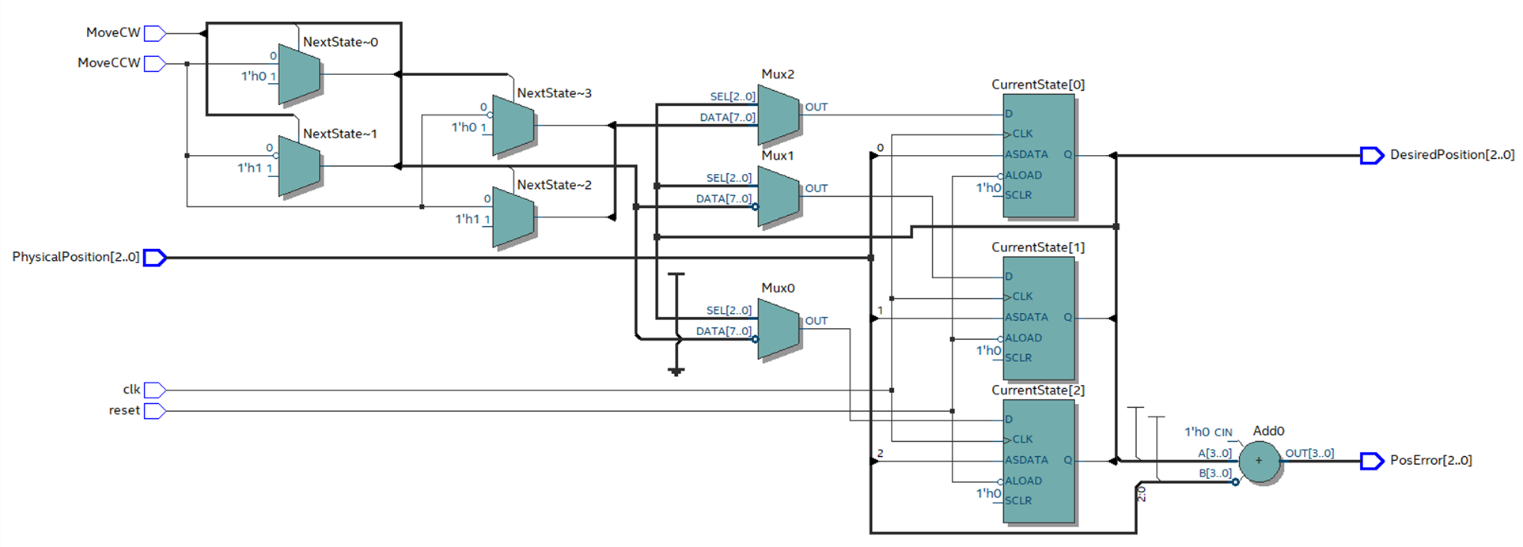
Binary Encoding - Schematic
Copyright © 2019 University of Colorado

Slide 109
State Encoding - Compare Cell Usage
Encoding | Registers (FFs) | Total Logic Cells FSM | Output Encoding Conversion Logic | Total Logic Cells
Binary | 3 | 17 | 0 | 17
Gray | 3 | 20 | 9 | 29
Johnson | 4 | 36 | 9 | 51
One-Hot | 8 | 107 | 33 | 146
Copyright © 2019 University of Colorado

Slide 110
Summary – Finite State Machines in VHDL
In this video, you have learned:
The rationale for use of Finite State Machines
How to create Finite State Machines
Some criteria for determining which state encoding formats to use
Copyright © 2019 University of Colorado

